Slide 1




"DAYS ON MARKET PREDICTOR FOR VEHICLE SALES OPTIMIZATION"
CMPT 3830: Machine Learning Work Integrated Project-1

Slide 2


CONTENT
Overview
Introduction
Team members
Data preprocessing
Exploratory Data Analysis
Visualization
Feature Encoding
Questions

Slide 3

DESCRIPTION OF GO AUTO'S DATASET
Dataset Details: The dataset contains 145,114 entries with 47 features, covering a wide range of vehicle and dealership information.
City Coverage: The cities included in the dataset are Archeson, Devon, Edmonton, Fort Saskatchewan, Leduc, Nisku, Sherwood Park, Spruce Grove, and St. Alberta.
Scope of Data: The dataset spans the last 30 days and includes both active and sold vehicle listings from multiple dealerships.

Slide 4

Feature Overview:
Listing
Information
Vehicle Feature
Dealer Information
Feature Overview
Sales Analysis
Vehicle Information
Dealer specific Metrics

Slide 5

INTRODUCTION
Problem: The challenge is to predict the number of days a vehicle will stay on the market before being sold.
Goal: Build a regression model to predict the "days on market" for each vehicle, helping optimize sales and inventory decisions.

Slide 6




TEAM
REGRESSION REBELS
1
2
3
4
ROHIT
3095056
HTTPS://WWW.LINKEDIN.COM/IN/ROHIT-ROHIT-97021128B/
ABHINAV DATT
3097389
HTTPS://WWW.LINKEDIN.COM/IN/ABHINAV-DATT-8A726128A/
SPANDAN DAHAL
3092592
HTTPS://WWW.LINKEDIN.COM/IN/SPANDAN-DAHAL-6747962A4/
JATIN DHANDAN
3095052
HTTPS://WWW.LINKEDIN.COM/IN/JATIN-DANDYAN-6831692A5/

Slide 7


KEY FEATURES FOR PREDICTING DAYS ON MARKET
Model Year
Make
Model
Mileage
price
msrp
Transmission
Fuel Type
Days on Market

Slide 8

INITIAL DATA PREPARATION
1
Library Import:
To perform the analysis, necessary libraries were imported:
Pandas : For data manipulation and analysis.
NumPy : For numerical operations.
Matplotlib and Seaborn : For data visualization and plotting.
OUR
1
Loading the Dataset:
The dataset (CBB_Listings_cleaned1.csv) was loaded into a DataFrame (df) using Pandas. This enabled easy access and manipulation of the dataset.
Used .info() to summarize the dataset, including entries, column names, data types, and to identify missing values.

Slide 9
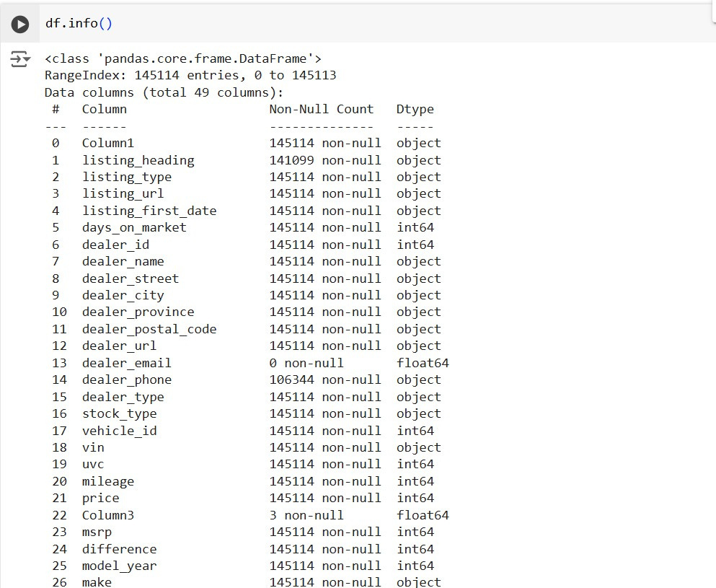

Slide 10

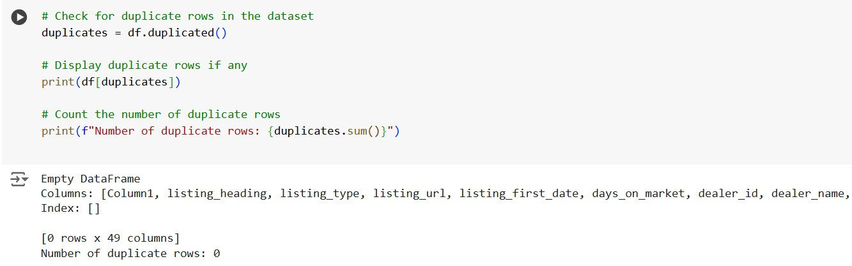
We use df.duplicated() to check for duplicate rows in the dataset.
CHECKING FOR DUPLICATES IN THE DATASET:
In our case, no duplicate rows were found, resulting in an empty DataFrame.
Number of Duplicate Rows: 0

Slide 11

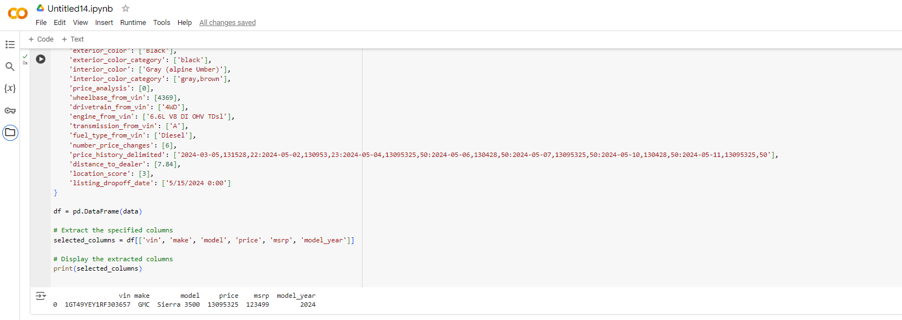
OUTLIER HANDLING:
As you can see in the picture the price some for the cars are unreasonably very high so we have considered it as outlier
We have handled the outlier by removing the last two digit or one digit from price by comparing it with msrp which made the price more resonable and hence handling the outlier

Slide 12
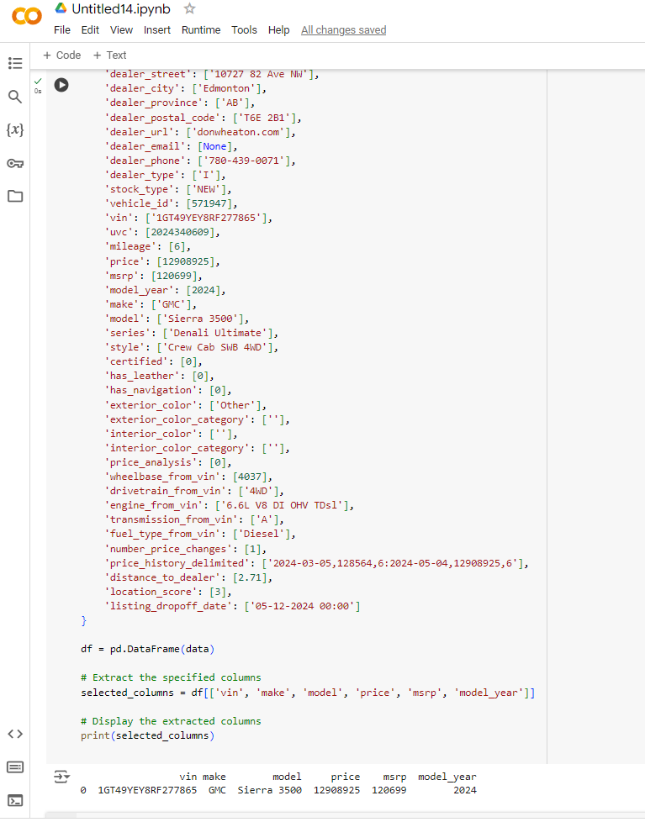
Another Example:

Slide 13
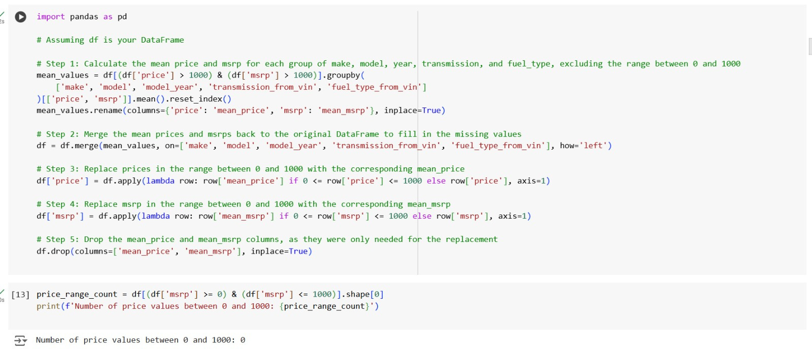
OUTLIER HANDLING:
Identifying Price Outliers: Prices between 0 and 1000 were flagged as outliers.
Replacing Outliers: Outlier values for price and msrp were replaced with group means calculated based on similar attributes (e.g., make, model, model_year, transmission_type, and fuel_type). This kept pricing data consistent.

Slide 14
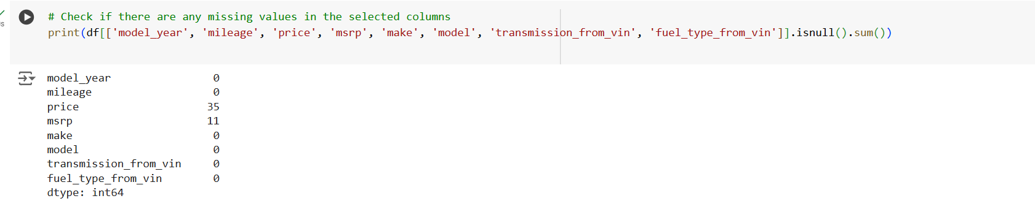
HANDLING MISSING VALUES:
Checking Missing Values: Missing values were identified for key columns like price, msrp, and model year.
Filling Missing Values:
Checking for any missing values

Slide 15
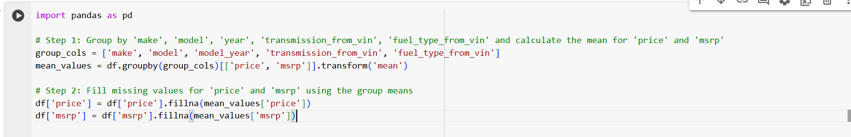
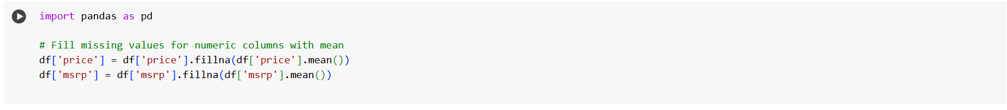
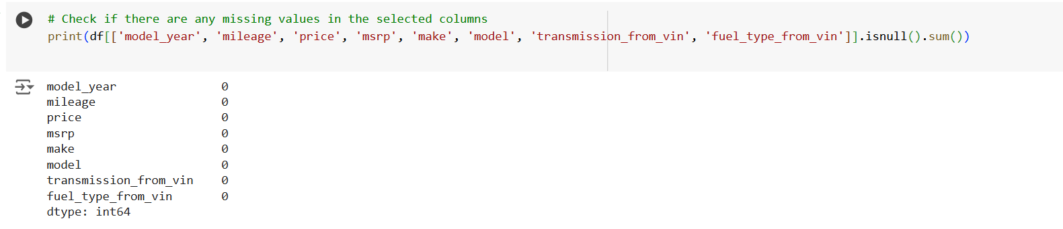
Price and msrp were filled using group means (based on similar attributes like make, model, year).
Other numerical columns were filled using the overall mean to retain data
Rechecking: The dataset was rechecked to confirm all missing values were filled, ensuring completeness for model training.

Slide 16
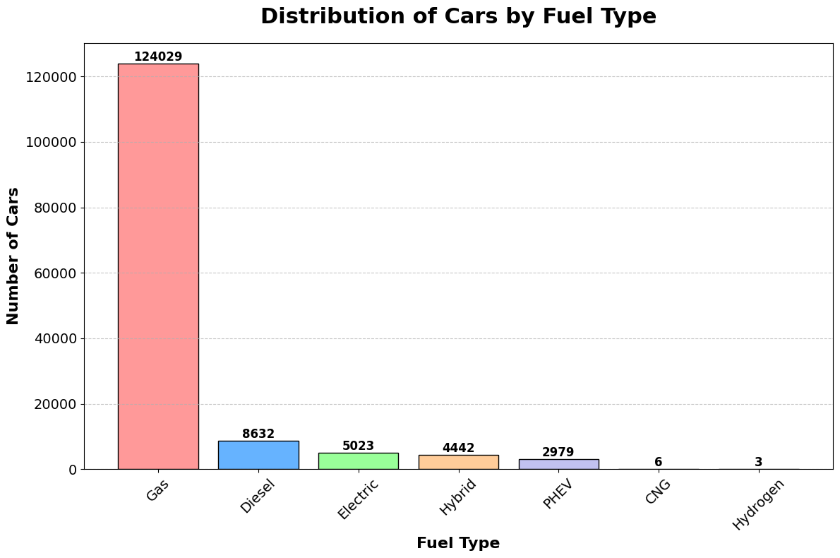
Distribution of Cars by Fuel Type
A bar chart was created to show the distribution of cars by fuel type:
Fuel Type Count:
The number of cars for each fuel type was counted and sorted.
This helps us see how many cars are gasoline, diesel, electric, etc.
2.Insights:
The chart helps us understand which fuel types are most common in the dataset, such as gasoline being dominant or fewer electric vehicles.

Slide 17
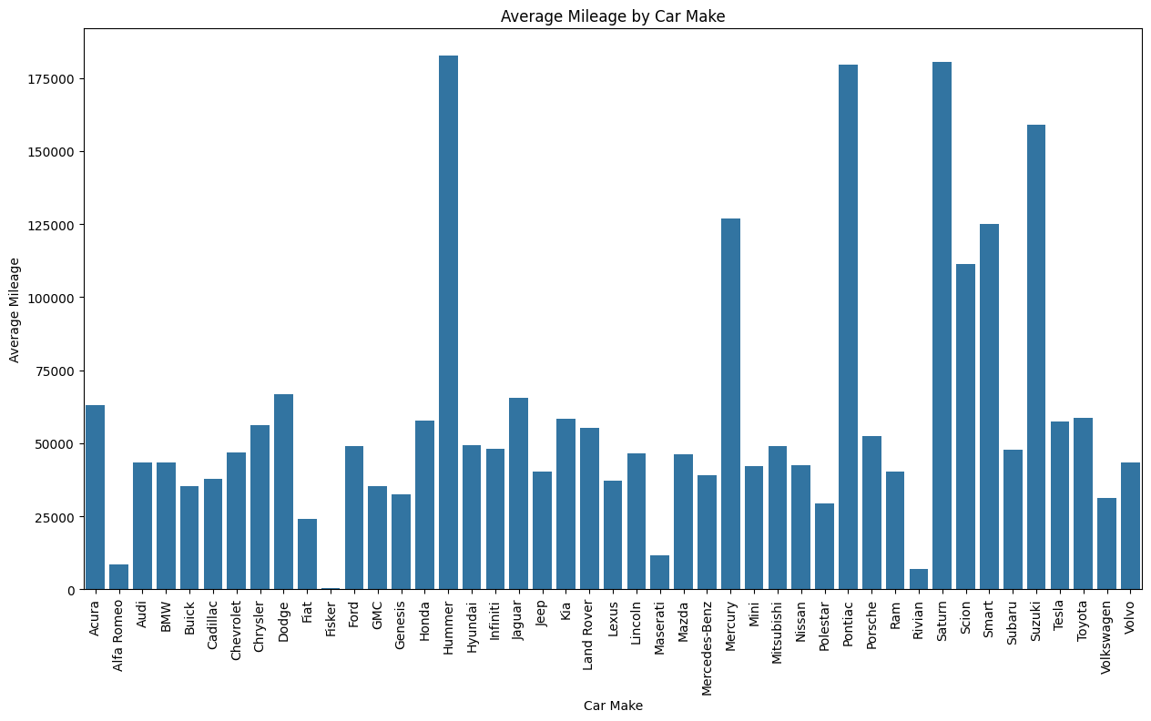

Slide 18
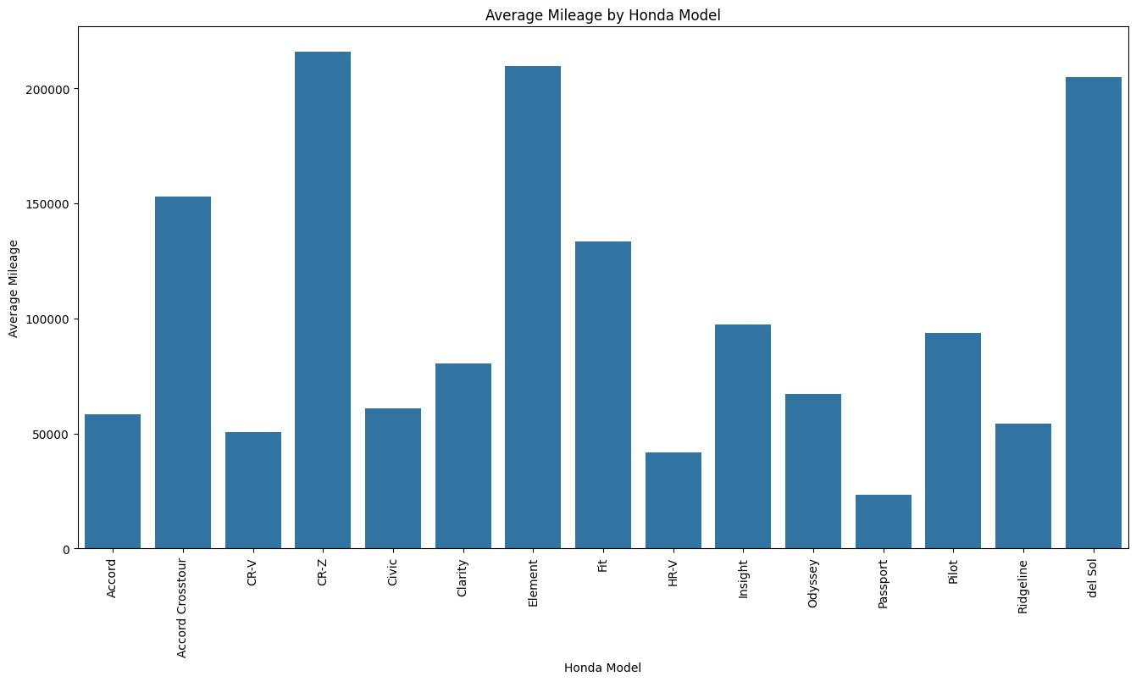

Slide 19
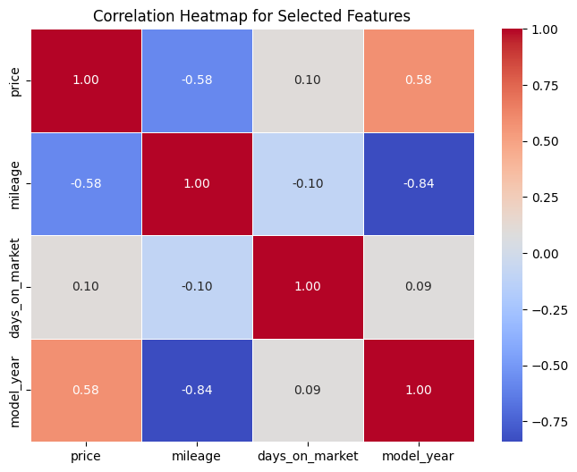
CORRELATION HEATMAP ANALYSIS
Insights from the Heatmap:
Price and days_on_market: Understanding the relationship between price and days on market is crucial for pricing strategy. For instance, if the correlation is positive, higher prices might be associated with longer listing times.
Impact on Modeling: Understanding these relationships helps prioritize features that influence days on market, improving model accuracy.

Slide 20
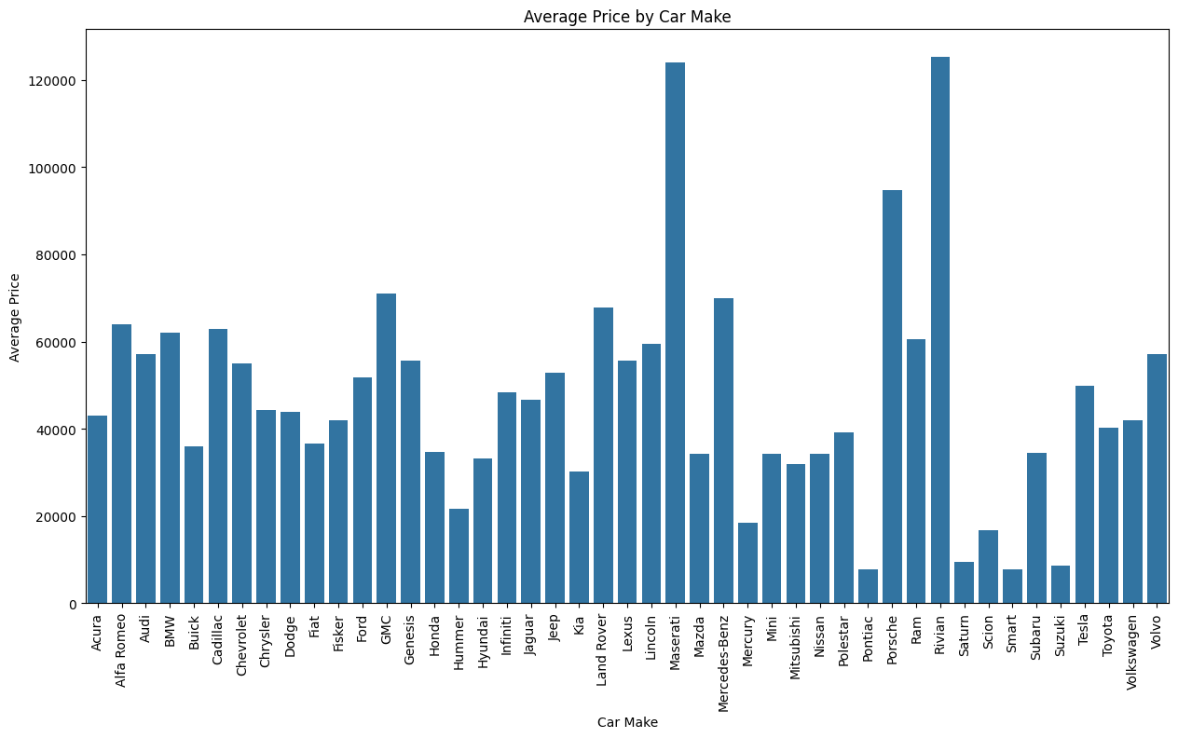

Slide 21
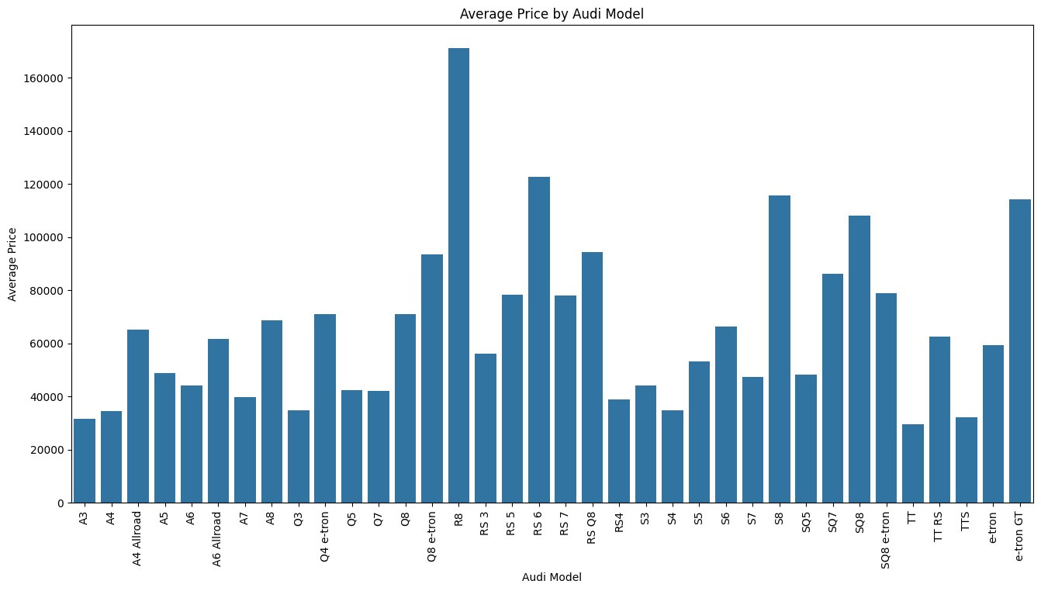

Slide 22
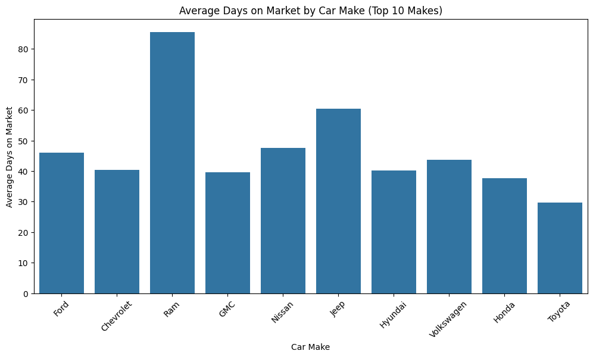
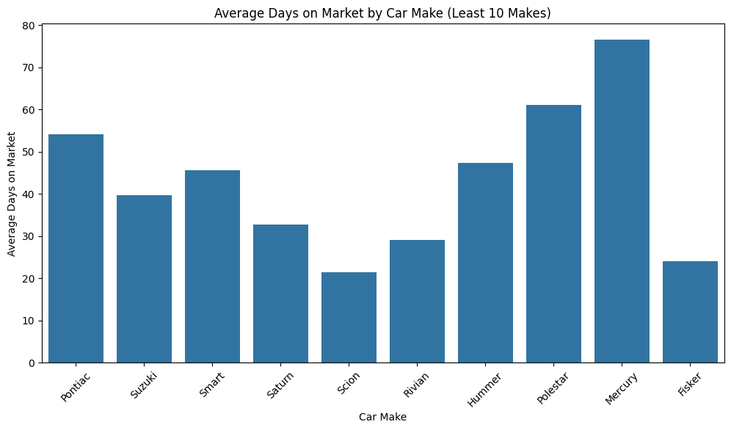

Slide 23
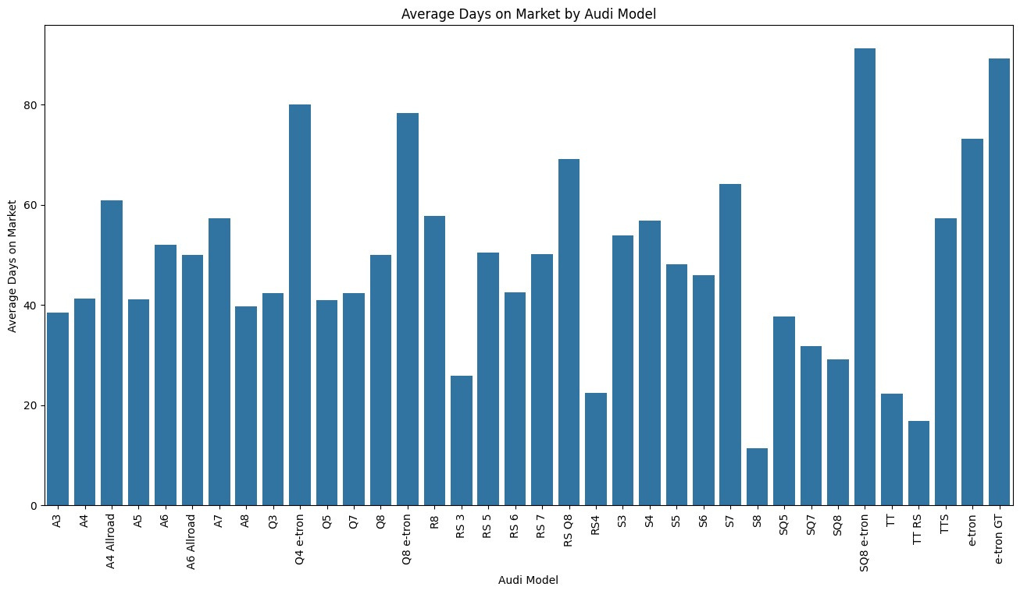

Slide 24
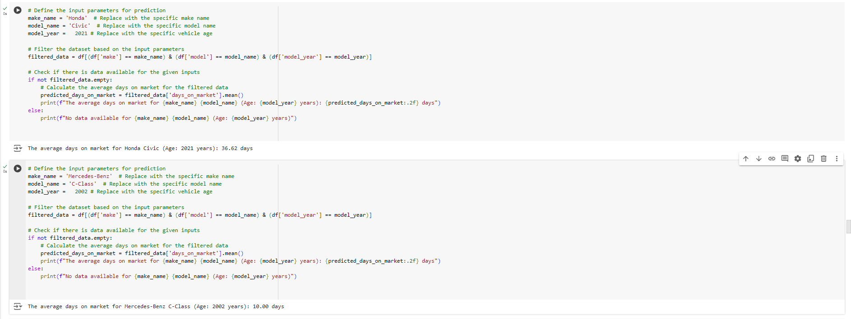

Slide 25
Data Encoding:
To prepare the dataset for machine learning, several encoding steps were applied to convert categorical data into numerical formats that models can use effectively. Here is an overview of the encoding process:
Transmission Type Encoding:
Transmission Mapping: The column transmission_from_vin was mapped with 0 for Automatic (A) and 1 for Manual (M) and similarly 6 to Manual (M) and 7 to Automatic (A) because number of 6 is and 7 is more which simontaneusly align with dataset as it has more automatic than mannual cars.This made it easier for the model to understand and use the transmission type as a feature.
2. One Hot Encoding For Fuel Type Encoding:
One-Hot Encoding: Transformed 'fuel_type_from_vin' column into separate binary columns using pandas.get_dummies(), ensuring categorical data is suitable for machine learning.
3. One-Hot Encoding for Make and Model:
make and model columns, which contain a wide range of categories, were one-hot encoded. This approach created separate binary columns for each unique car make and model.
This was important to ensure that the categorical information was represented in a way that didn't impose any ordering or ranking among the makes and models.
Standardization of Numerical Features:
Standardization of Numerical Features: Transformed 'model_year', 'mileage', 'price', 'msrp', and 'days_on_market' to scale values between 0 and 1.
Goal: Achieved a standard deviation of 1 to ensure all features contribute equally to the model, enhancing performance and stability.

Slide 26

QUESTION
& ANSWERS

Slide 27

THANK
YOU

